Slide 1
Java Application Development with Tomcat
Course Overview

Slide 2
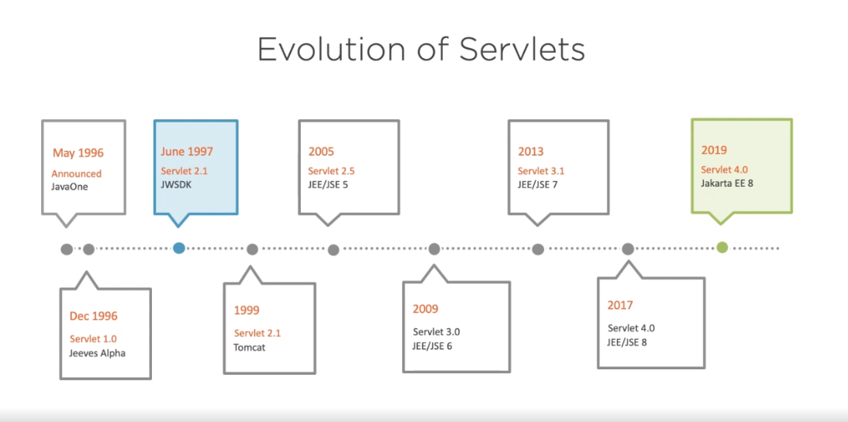

Slide 4
